Slide 1
FinTech or Automated Finance

Slide 2

The Macro-Economic Case for FinTech
After the 2008 GFC
Bankers are not infallible
Banks’ profits are not due to expertise but are economic rents
Innovation was technologically possible
Nakamoto posted the BitCoin white paper.

Slide 3

Economic Rents
Economic Rents are ``extra’’ revenues.
Usually associated with market power.
A monopolist earns economic rents

Slide 4
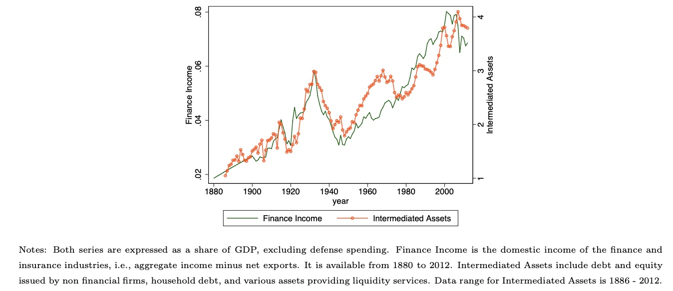
Finance Income and Intermediated Assets over GDP
The Finance Industry and
its role in the economy have been growing over time.
Source: Phillipon(2015) ``Has the US Finance Industry Become less efficient?

Slide 5
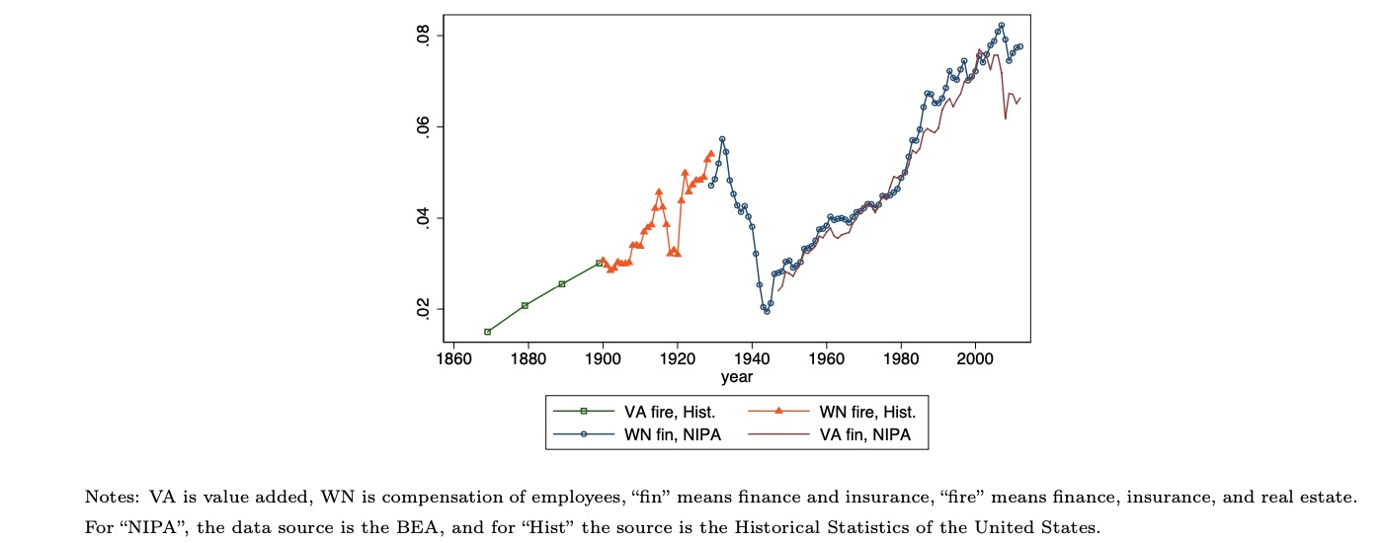
Wages and Value Added of Finance Industry
Source: Phillipon(2015) ``Has the US Finance Industry Become less efficient?

Slide 6
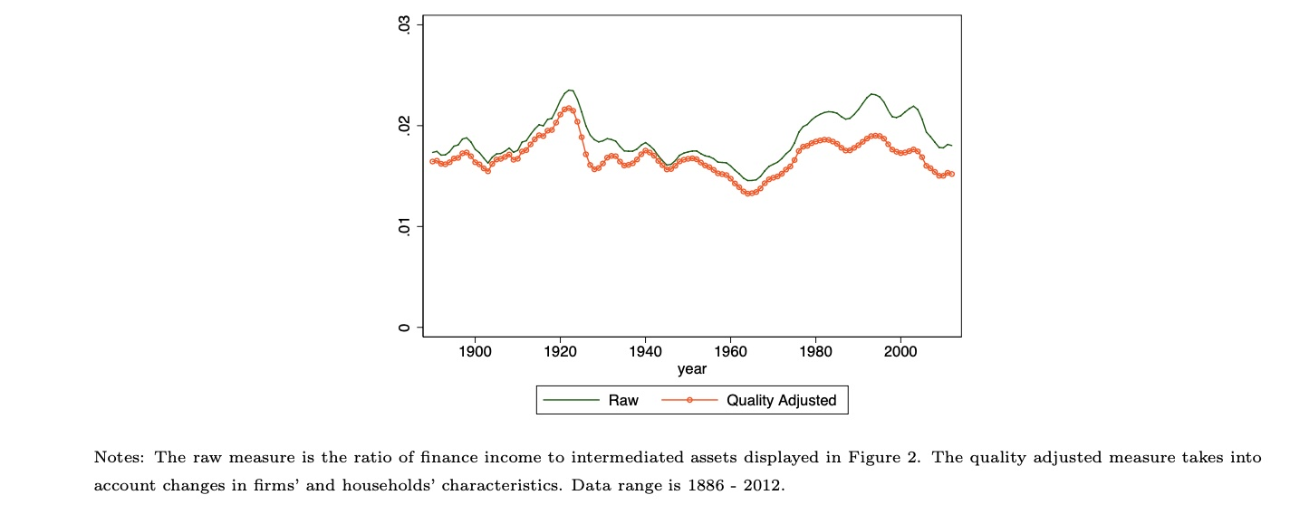
Unit Cost of Financial Intermediation
Source: Phillipon(2015) ``Has the US Finance Industry Become less efficient?

Slide 7
Financial Sector
It is large, profitable and hasn’t shown efficiency gains.
Incentive to Innovate
New Technology
Cloud based software (rent not buy)
Pay as you go platforms (rent not buy)
Open Source data
Cheaper to innovate: Don’t need high cash flows to break even

Slide 8
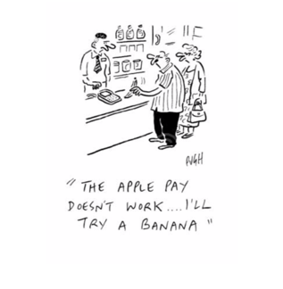
What is a payment system?
Way to transfer value.
Either physically (cash, gold) or across accounts.
Cash or gold are tokens that represent value.
Transferring across accounts usually goes through a bank to settle
Payments are a lucrative business

Slide 9
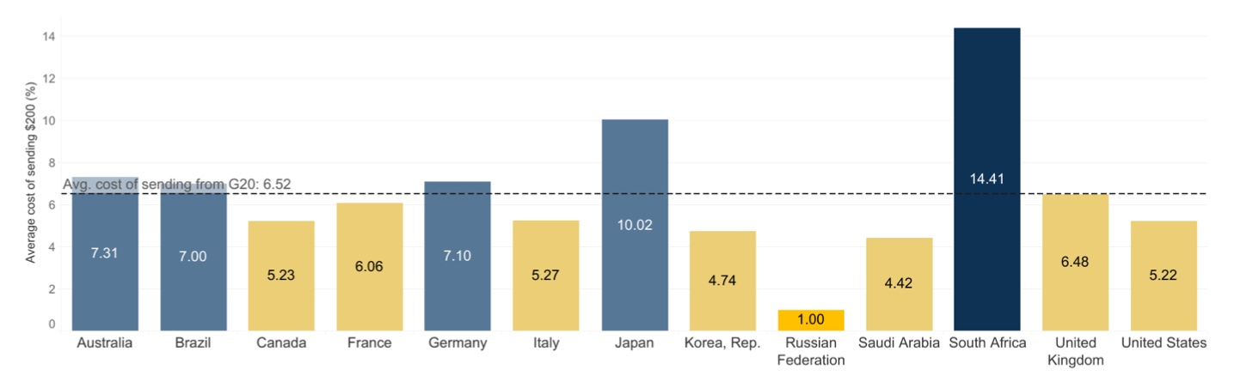
Average Cost of Remittances from G20
Source: World Bank Remittances Prices Worldwide Dec 2020

Slide 10






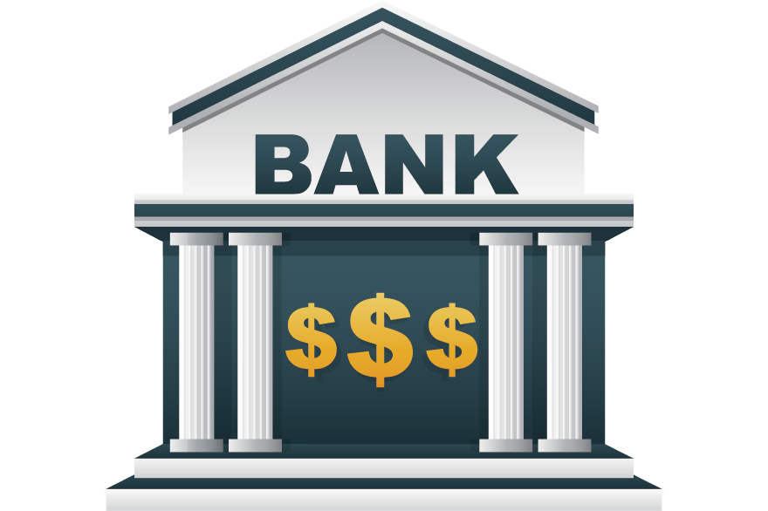
Payments are economically simple, but logistically complex.
SettlementAccount or Federal Reserve
.
Message to network or bank +100
Merchant gets $100
To Customer Bank
Customer Bank transfers $100 to merchant bank
This Photo by Unknown Author is licensed under CC BY-NC

Slide 11
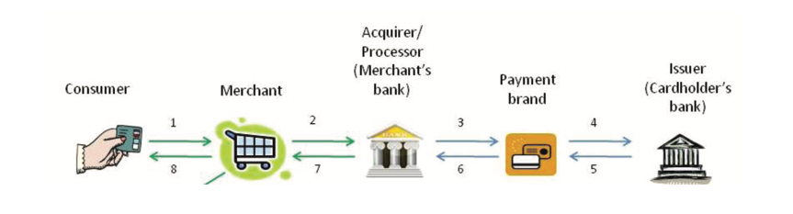
What do CC networks do?
Consumer selects a card, and it goes to the merchant’s Point of Sale Device (POS)
Data is sent to the merchant’s bank. Also known as the ``merchant acquirer’’
Data is sent to the payment brand
Customer’s bank (the issuing bank) verifies the data and sends authorization

Slide 12
Cash Flows and Payments
Visa
Assessment fee of 13bps.
Interchange fee of $2.35
Issuing Bank
Acquiring Bank
Discount of $3
Price=$100
Pays $100 Bill
May get points
$100 worth of goods
Customer
Merchant

Slide 13
Definitions
Interchange Fee: The fee that the merchant’s bank pays to the customer’s bank.
Provides an incentive for banks to issue credit cards
Some countries have zero interchange fees e.g. Canada, Denmark, Finland
Constant source of litigation
Merchant discount: The % of the transaction that the merchant pays to its bank.
Discount depends on the type of purchase (e.g. alcohol versus food) and the size of the merchant (e.g. Walmart versus artisanal baker)
Assessment Fee: Fee paid by the merchants to the network.

Slide 14
Payment Processing is Profitable
Visa net income is around 12 billion
The company is not exposed to customer credit risk and makes no revenue on fees.
Cash is anonymous, but payment processors know how money is spent.
Electronic payments generate big data sell for advertising.
Is there a distributed competitor to traditional payment cards?

Slide 15











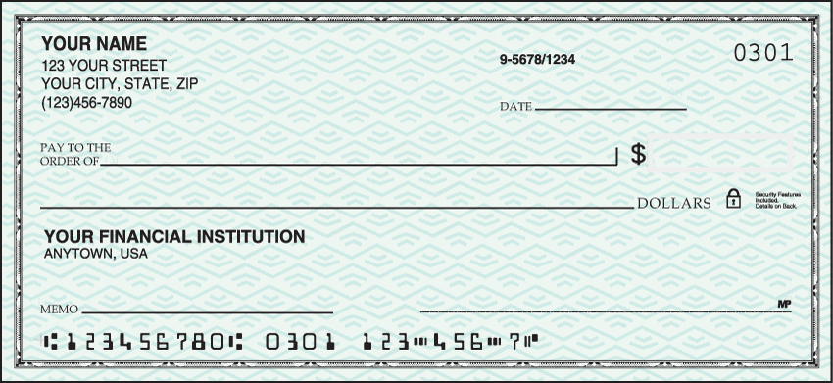
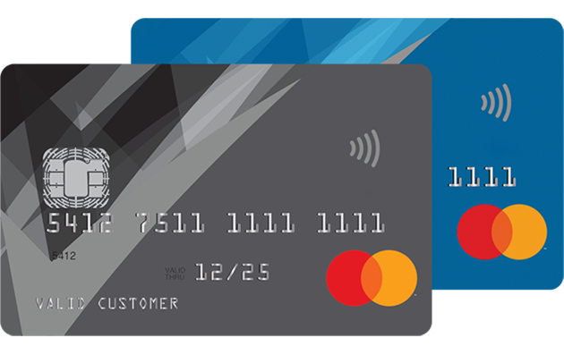
Rapid Innovation
2022
2023
Digital
Yuan
SWIFT
ACH
Bitcoin
2022
1973
1974
1998
2009
2010
2017
CHIPS
1970
Venmo
1950
FedWire
Check
Card
1915
1790

Slide 16
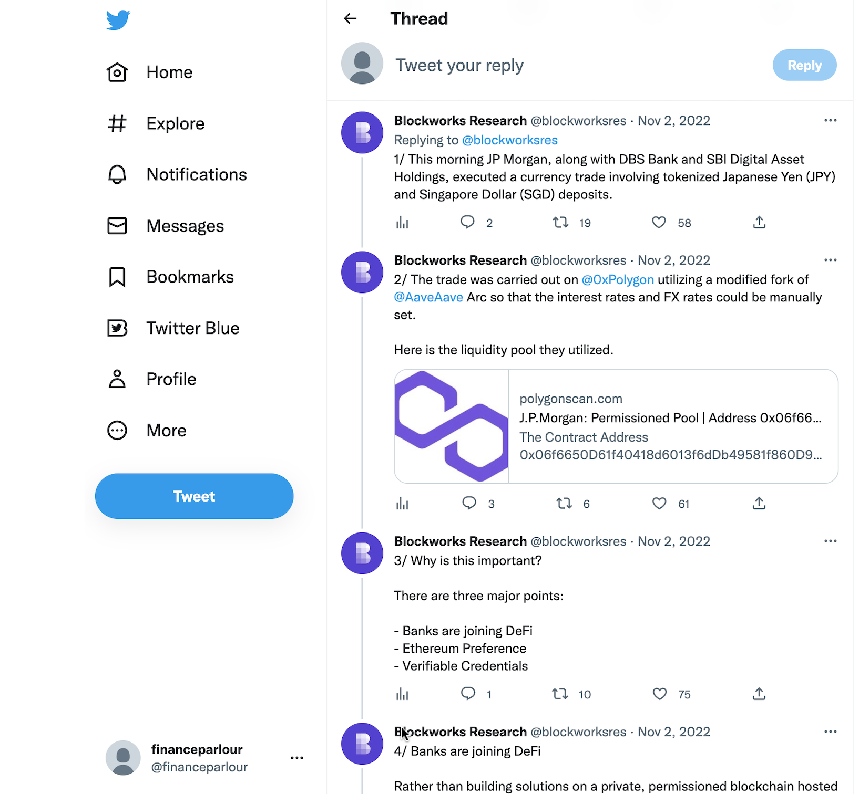
TradFi is Taking notice….
Source: Elon Musk

Slide 17
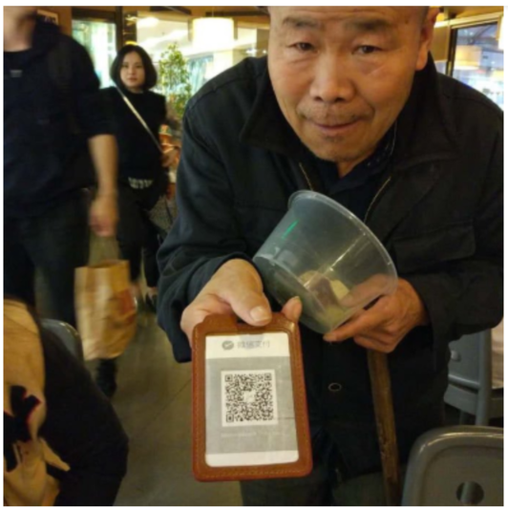
FinTech
Technology reduces the cost of traditional finance.
Makes Financial Markets and products more accessible.
Technology changes how finance is organized.
New business models

